Slide 1


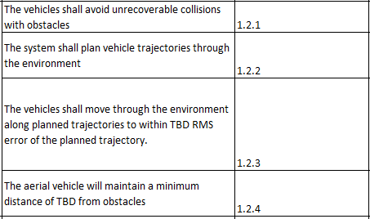
FlyNet: Planning
Requirements Motivation

Slide 2
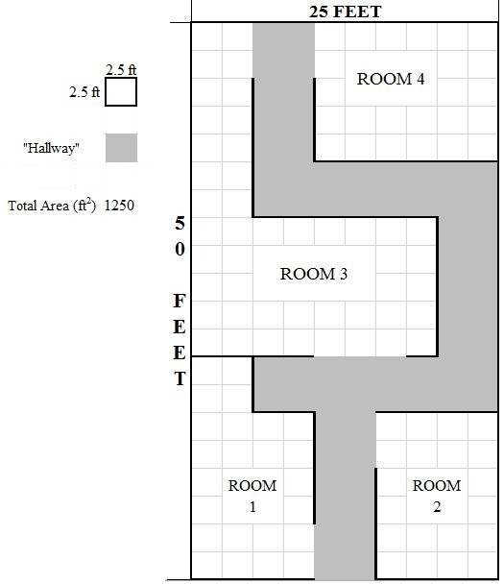
FlyNet: Planning
Generate initial path to explore space
Plan path for feasible dynamics
Plan path to avoid obstacles
Efficiently search space

Slide 3
FlyNet: Planning
Generate initial path to explore space
Plan path for feasible dynamics
Plan path to avoid obstacles
Efficiently search space
Update plan based on dynamic environment
“Roadblock”
“Target”
“Complete Block”

Slide 4
FlyNet: Planning
Generate initial path to explore space
Plan path for feasible dynamics
Plan path to avoid obstacles
Efficiently search space
Update plan based on dynamic environment
“Roadblock”
“Target”
“Complete Block”

Slide 5
FlyNet: Planning
Plath Planning Alternatives
Cell Decomposition
Break the map down into a grid
Determine valid connections in the grid space
Easy/fast to compute
Cannot capture complex vehicle dynamics
Potential Fields
Generate potential fields for plan
Attract to desired trajectory
Repel from obstacles
Easy/fast to compute
Struggles with local minima (ie rooms)
Sampling based methods
Sample potential robot states randomly
Connect states by checking for collisions and dynamics feasibility
Captures high-dimensional robot states
Captures complex problem constraints
See: http://ompl.kavrakilab.org/OMPL_Primer.pdf

Slide 6
FlyNet: Planning
Plath Planning Alternatives
Cell Decomposition
Break the map down into a grid
Determine valid connections in the grid space
Easy/fast to compute
Cannot capture complex vehicle dynamics
Potential Fields
Generate potential fields for plan
Attract to desired trajectory
Repel from obstacles
Easy/fast to compute
Struggles with local minima (ie rooms)
Sampling based methods
Sample potential robot states randomly
Connect states by checking for collisions and dynamics feasibility
Captures high-dimensional robot states
Captures complex problem constraints
See: http://ompl.kavrakilab.org/OMPL_Primer.pdf

Slide 7
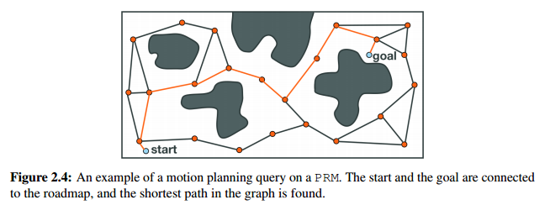
FlyNet: Planning
Path Planning Alternatives
Probabilistic Roadmap
Randomly sample robotic states over the entire space
Connect states using collision detection and dynamics verification
Use this map to plan movements through space
Query this roadmap for new goals
Need to re-plan roadmap if environment changes
From: http://ompl.kavrakilab.org/OMPL_Primer.pdf

Slide 8
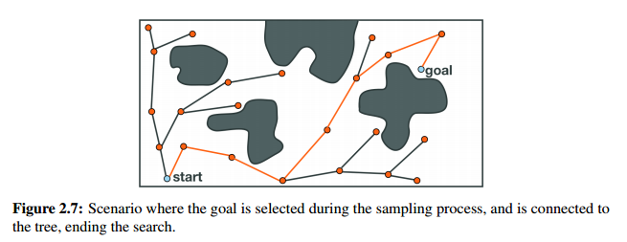
FlyNet: Planning
Plath Planning Alternatives
Tree-Based Planners
Seed a tree at the origin
Randomly sample states near the current location
Connect to all valid states based on collision detection and dynamics
Grow this tree until we get to the goal
Generates a single path from start to goal
Need to grow a new tree for re-planning
From: http://ompl.kavrakilab.org/OMPL_Primer.pdf

Slide 9
FlyNet: Planning
Plath Planning Alternatives
Tree-Based Planners
Seed a tree at the origin
Randomly sample states near the current location
Connect to all valid states based on collision detection and dynamics
Grow this tree until we get to the goal
Generates a single path from start to goal
Need to grow a new tree for re-planning
From: http://ompl.kavrakilab.org/OMPL_Primer.pdf

Slide 10
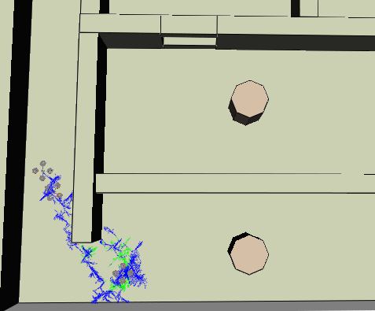
FlyNet: Planning
The Open Motion Planning Library
Open-source library with implementations of sample-based planning algorithms
Provides plug-ins to ROS or standalone c++
Supports basic modeling of quad rotors moving in 3D Environment
Uses point-mass model of quad with thrust and angular acceleration as controls
Environment is defined by CAD model
Initial path planning conducted for built-in environment using RRT
Top-Down View
Goal
Start
Trajectory

Slide 11
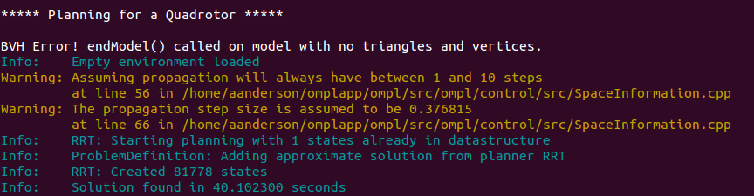
FlyNet: Planning
The Open Motion Planning Library
Supports benchmarking of planners
So far, 3D planners seem to take significant amounts of time:
40 seconds for an empty space!

Slide 12
FlyNet: Planning
Path Planning Issues
Path planning can generate a near optimal trajectory for getting between a start position and goal
Ability to plan with well known map can generate trajectories free of obstacles in highly complex environment
Require minimal human input
3D path planning can be time consuming

Slide 13
FlyNet: Planning
Path Planning Issues
Path planning can generate a near optimal trajectory for getting between a start position and goal <- We need to make the goals
Ability to plan with well known map can generate trajectories free of obstacles in highly complex environment <- Our environments contain uncertainties
Require minimal human input
3D path planning can be time consuming <- We will likely need to re-plan frequently

Slide 14
FlyNet: Planning
Block Diagram (In Development)
Feature Detection
Feature Mode
Mode Select
Target location estimate:
Local NED
Target Localization
POS Set-Point: NED
Local NED from SLAM
Command Mux
Attitude Set-Point: Ɵɸɣ
Obstacle Distance from Guidance
<
Trajectory Memory
Updated Map from SLAM
Re-Plan
A-priori MAP (CAD)
Offline Planner

Slide 15
FlyNet: Planning
Path Forward
Determine method for generating goal points
Base this on search coverage by projecting FLiR FoV
Explore options for 2D planning
Faster re-planning
Improve quadrotor model in OMPL
Give roll/pitch limits
Potentially eliminate orientation as a state for exploration
Benchmark various planning options in OMPL
Generate 3D or 2D model of our test space

